Slide 1
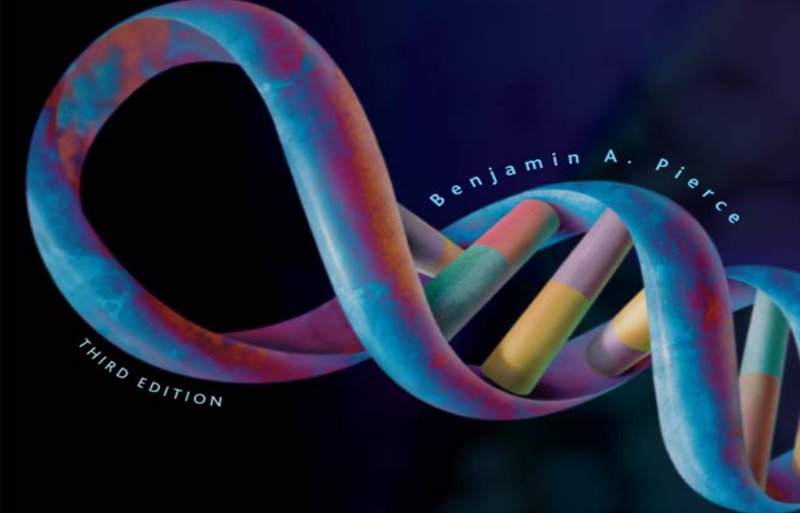
16 and 17 | Control of Gene Expression
© 2009 W. H. Freeman and Company

Slide 2
Gene Regulation in Bacterial and Eukaryotes
Gene regulation: Only a subset of genetic information is expressed at any time
Bacteria: responds to environmental changes by rapidly altering its biochemistry
Eukaryotes:
- Multicultural specialization – individual cells are specialized for particular task
- Response to environmental changes

Slide 3
Genes and Regulatory Elements:
DNA sequences that are transcribed and DNA sequences that regulate expression of the other sequences
Structural genes: encoding proteins used in biosynthesis, metabolism, or have structural role in the cell
Regulatory genes: encoding products that interact with other sequences and affect the transcription and translation of these sequences (many of them are DNA-binding proteins)
Regulatory elements: DNA sequences that are not transcribed but play a role in regulating other nucleotide sequences

Slide 4
Genes and Regulatory Elements:
Constitutive expression: continuously expressed under normal cellular conditions
Housekeeping genes- important for maintenance of cells (actin, ubiquitin)
The regulation of gene expression:
  Positive control: stimulate gene expression
  Negative control: inhibit gene expression

Slide 5
DNA-Binding Proteins
DNA- binding proteins have usually functional parts called domains: 60 ~ 90 amino acids, responsible for binding to DNA, forming hydrogen bonds with DNA
Their attachment to DNA affects the expression of genes – bind dynamically
Distinctive types of DNA-binding proteins based on the motif found within the binding domain – a simple structure that fits into the major groove of the DNA

Slide 6
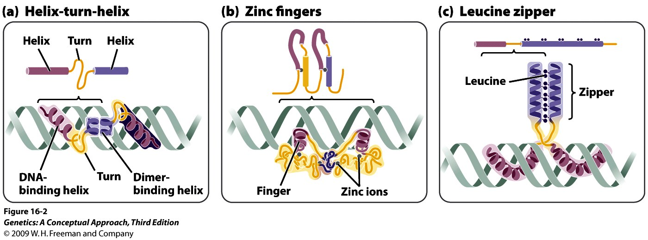
DNA-Binding Proteins
2 alpha helices connected by a turn
(Bacteria and Eukaryotes)
Loop of amino acids containing a zinc ion (Eukaryotic proteins)
Helix of leucine residues and zipper arm (Eukaryotic transcription factors)
Notes:
Figure 16.2 DNA-binding proteins can be grouped into several types on the basis of their structures, or motifs.

Slide 7
Operons Control Transcription in Bacterial Cells
Many bacterial genes with related functions are clustered and are under the control of single promoter – transcribed together into a single mRNA
Operon: promoter + additional sequences that control transcription (operator) + structure genes
Regulator gene: DNA sequence encoding products that affect the operon function are not part of the operon

Slide 8
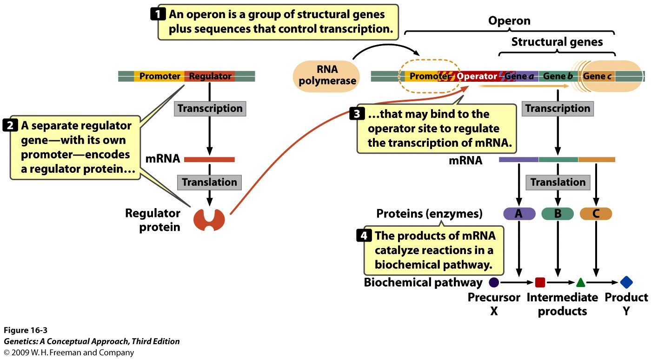
An operon is a single transcriptional unit that includes structural genes, a promoter, and an operator
Negative control: regulatory protein is a repressor
Positive control: regulatory protein is an activator
Inducible operons
Repressible operons
Notes:
Figure 16.3 An operon is a single transcriptional unit that includes a series of structural genes, a promoter, and an operator.

Slide 9
Inducible operons: Transcription is usually off and needs to be turned on.
Repressible operons: Transcription is normally on and needs to be turned off.
- Negative Inducible operons
- Negative Repressible operons
- Positive Inducible operons
- Positive Repressible operons
Inducer: small molecule that turns on the transcription (often an allosteric protein)

Slide 10
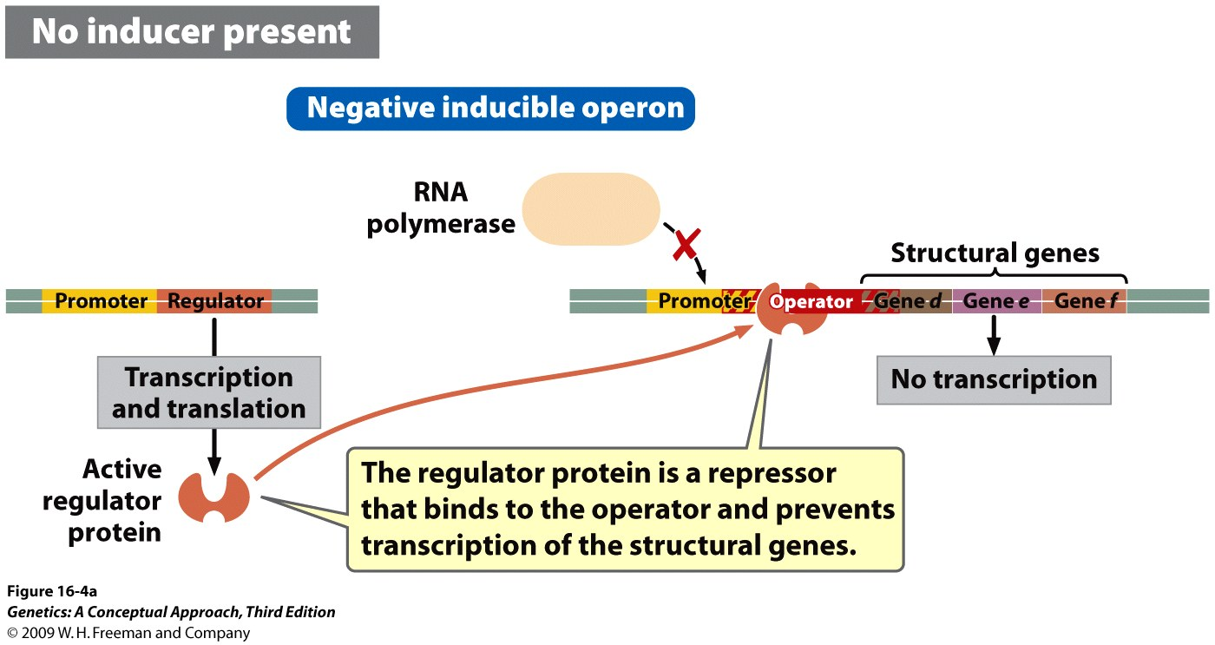
Negative inducible operons: The control at the operator site is negative. Molecule binding is to the operator, inhibiting transcription.
Notes:
Figure 16.4a Some operons are inducible.

Slide 11
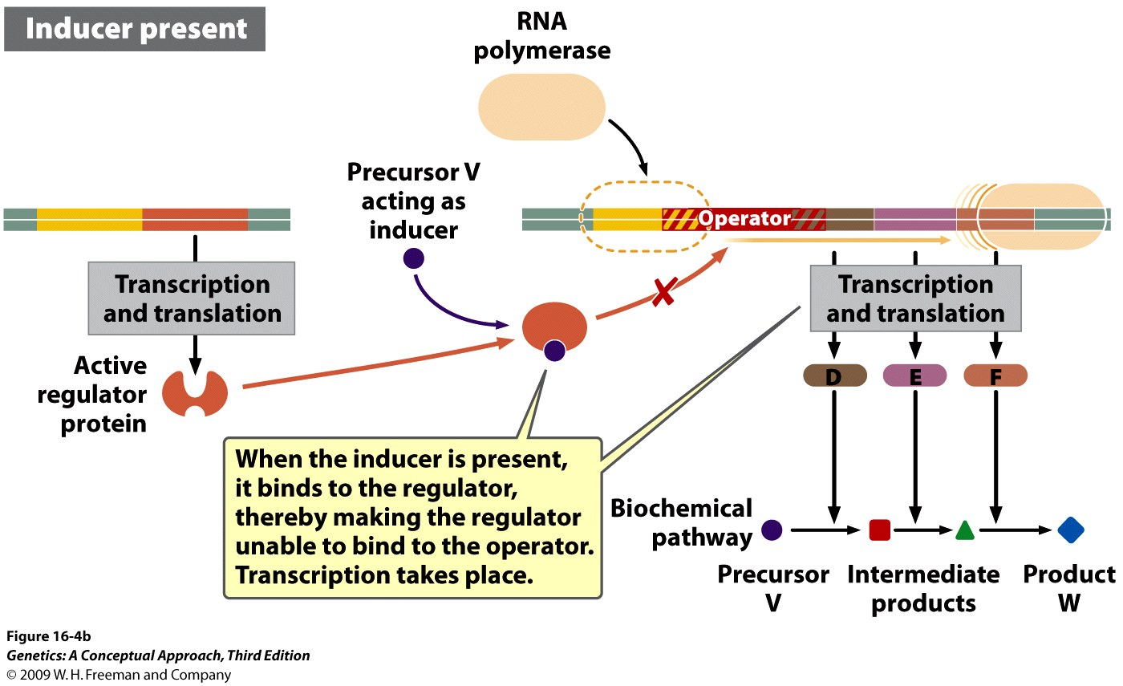
Negative inducible operons:
An example: The lac operon of E.coli
Notes:
Figure 16.4b Some operons are inducible.

Slide 12
Negative repressible operons:
The control at the operator site is negative.
Transcription is usually on and needs to be turned off, so the transcription is repressible.
Corepressor: a small molecule that binds to the repressor and makes it capable of binding to the operator to turn off transcription
Repressible operons usually controls synthesis of proteins that carry out the biosynthesis of molecules, such as amino acids

Slide 13
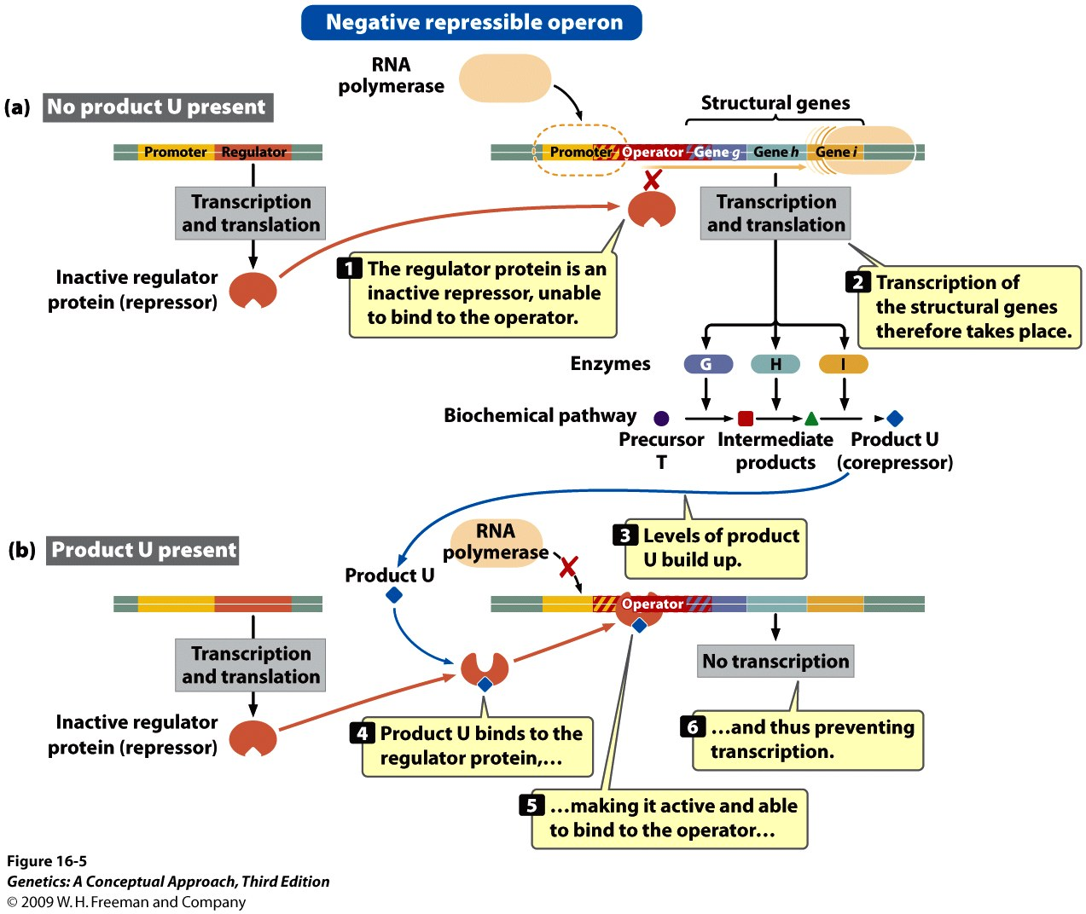
Notes:
Figure 16.5 Some operons are repressible.

Slide 14
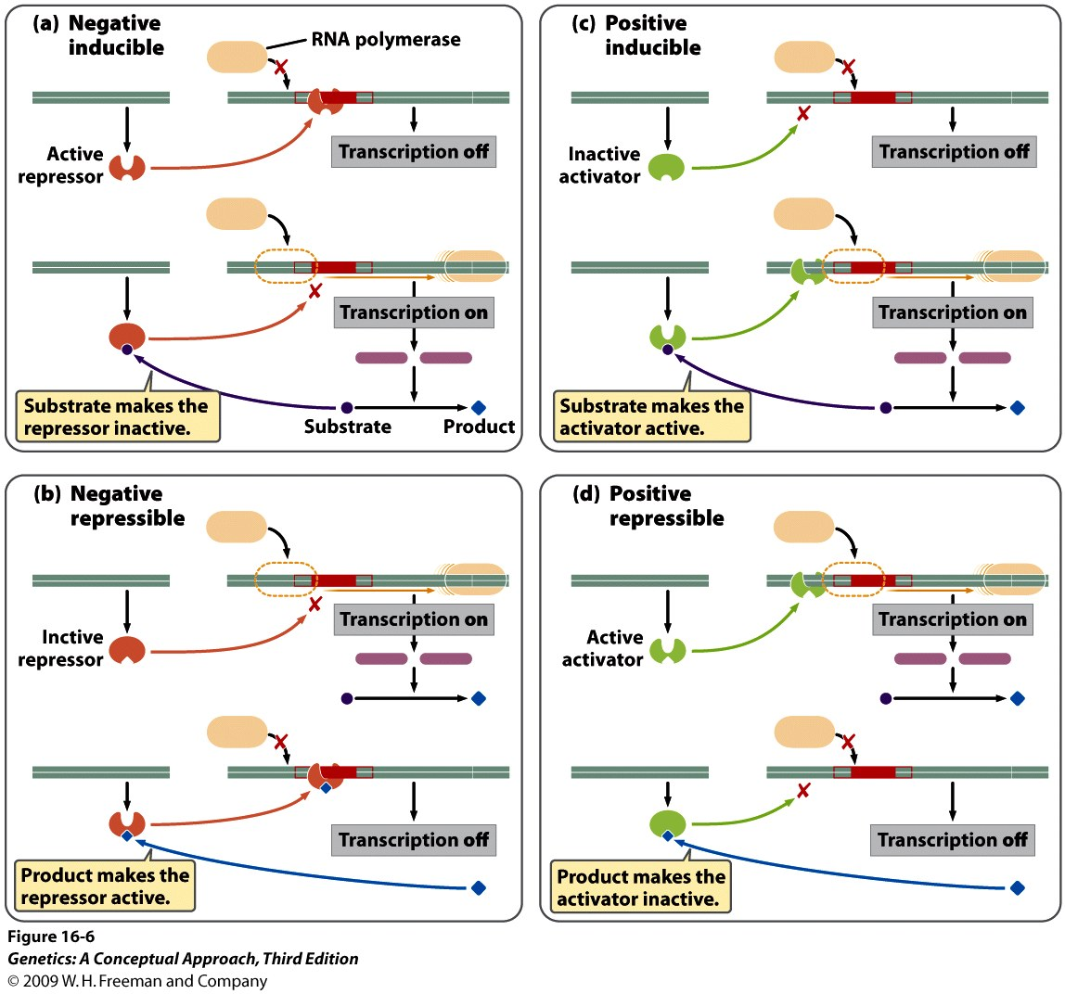
Notes:
Figure 16.6 A summary of the characteristics of positive and negative control in inducible and repressible operons.

Slide 15
The lac Operon of E. coli
Structural genes
  lacZ: encoding β-galactosidases
  lacY: encoding permease
  lacA: encoding transacetylase
The repression of the lac operon never completely shuts down transcription.

Slide 16
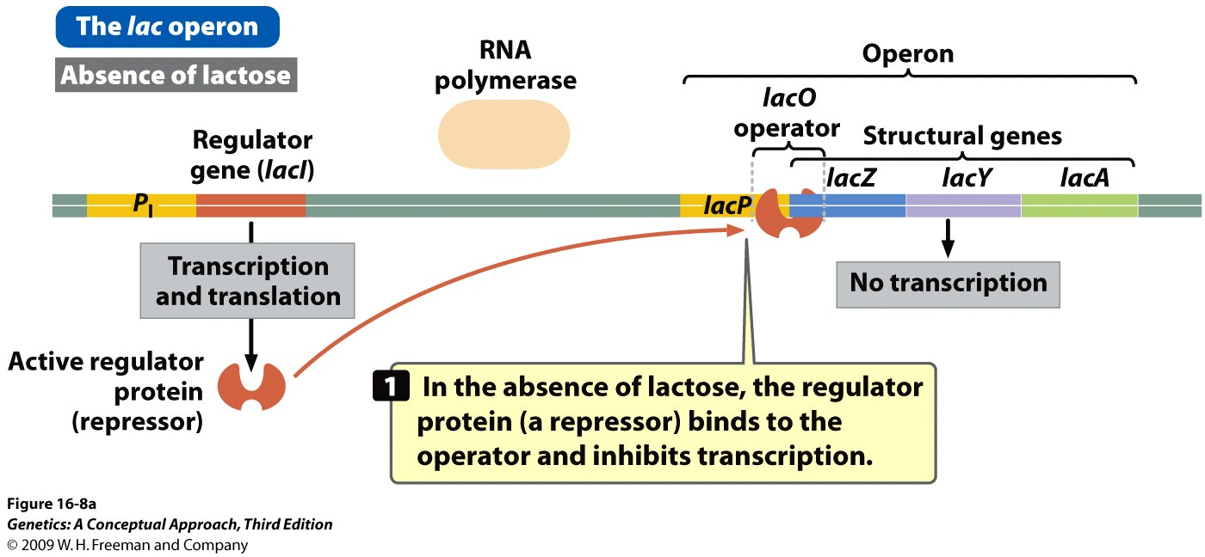
Notes:
Figure 16.8a The lac operon regulates lactose metabolism.

Slide 17
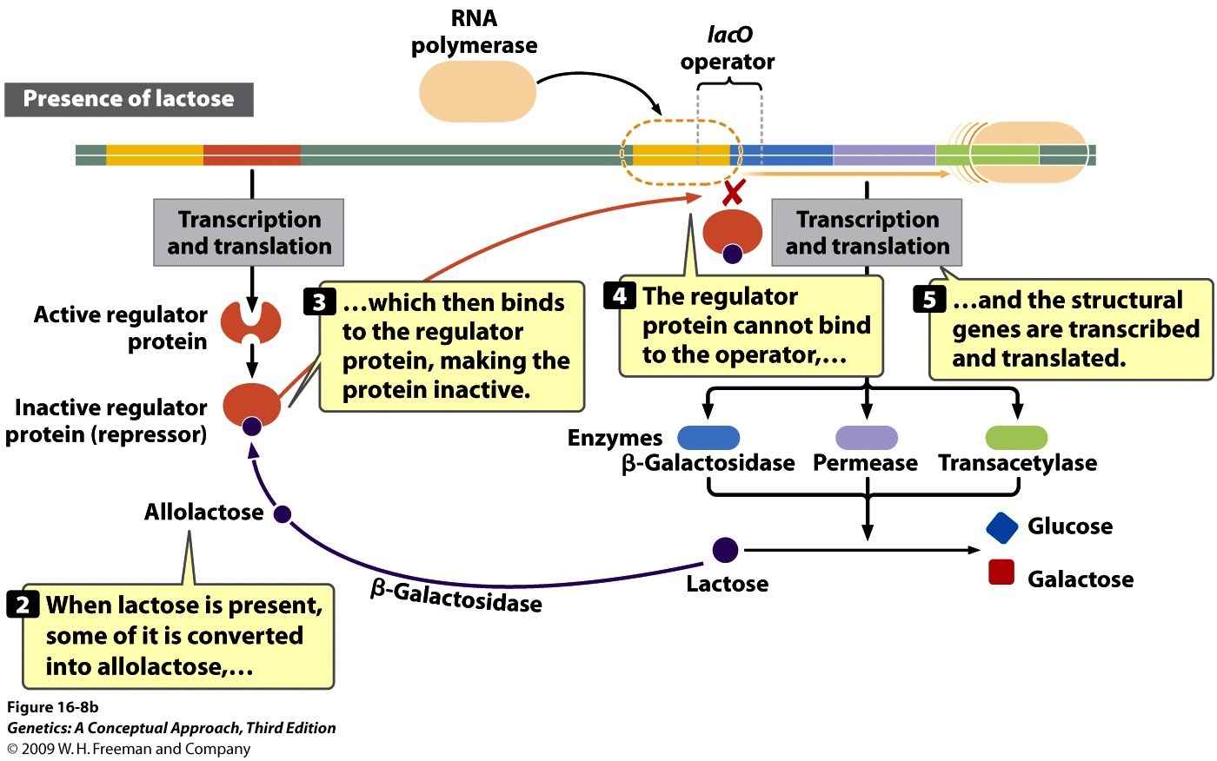
Notes:
Figure 16.8b The lac operon regulates lactose metabolism.

Slide 18
Eukaryotic Cells
Each structural gene has its own promoter, and is transcribed separately.
DNA must unwind from the histone proteins before transcription.
Activators are more common in Eukaryotes.
Transcription and translation are separated in time and space.

Slide 19
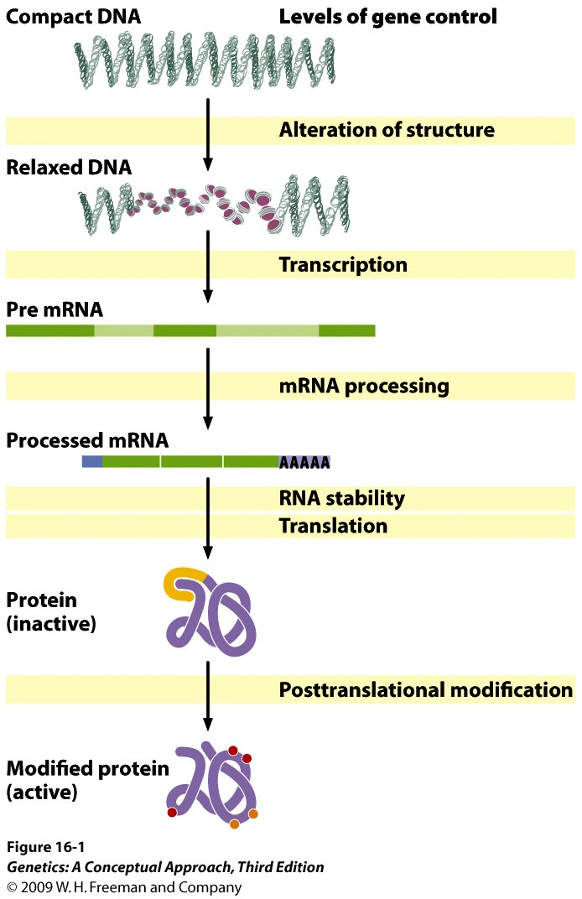
Levels of Gene Regulation
1.
2.
3.
4.
5.
6.

Slide 20
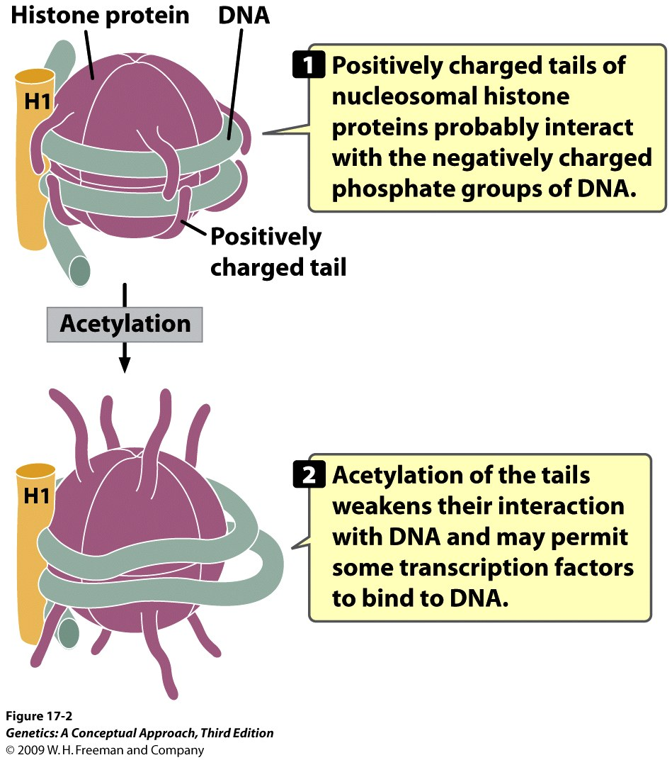
Changes in Chromatin Structure
  Histone modification
  Addition of methyl groups to the histone protein tails- activation or repression
  Addition of acetyl groups to histone proteins- activation

Slide 21
Changes in Chromatin Structure
Chromatin remodeling
Chromatin-remodeling complexes: bind directly to DNA sites and reposition nucleosomes – transcription factor binding and initiation of transcription
DNA methylation
DNA methylation of cytosine bases adjacent to guanine nucleotides (CpG)–CpG islands

Slide 22
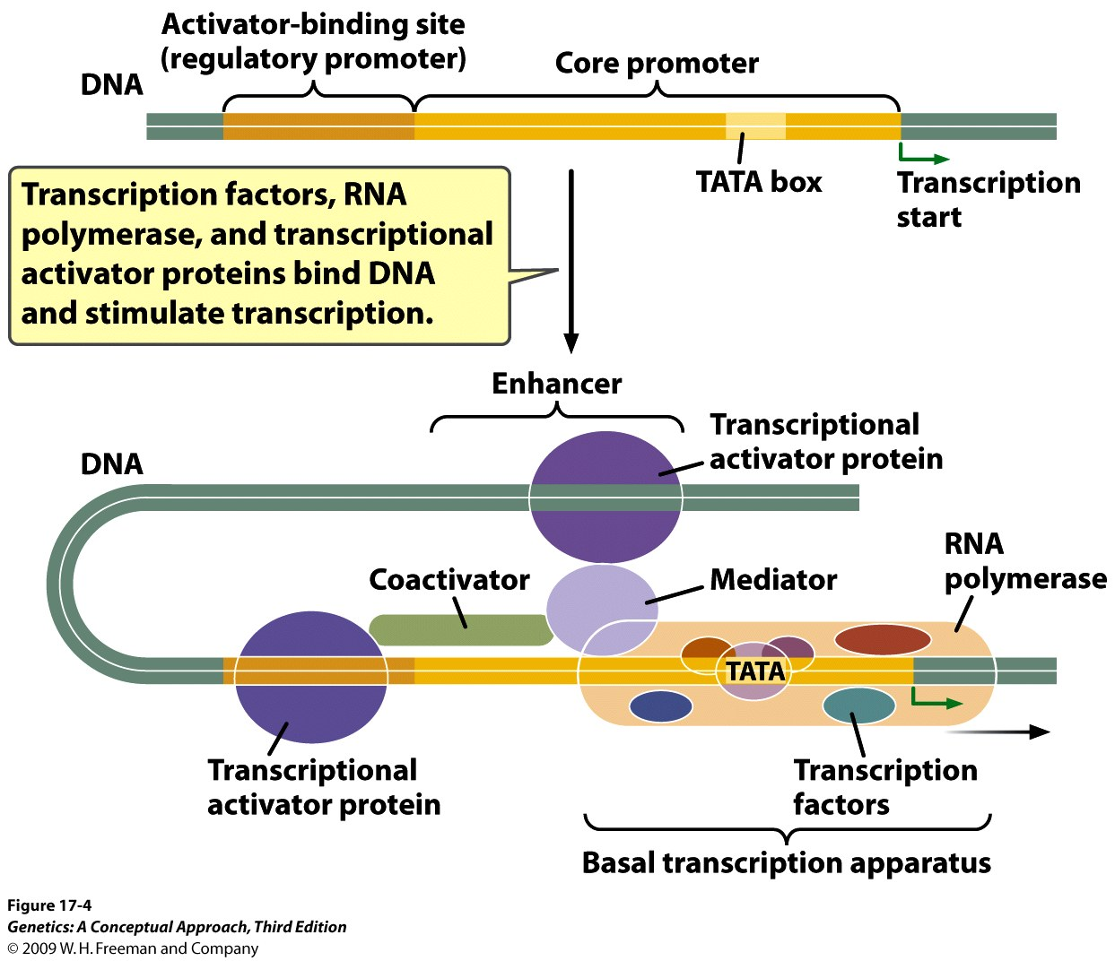
Transcriptional regulation:
The Initiation of Transcription Is Regulated by Transcription Factors and Transcriptional Activator Proteins (bind DNA usually at a
consensus
sequence and
interact with
components
of the
transcriptional
apparatus)
- Co-activators

Slide 23
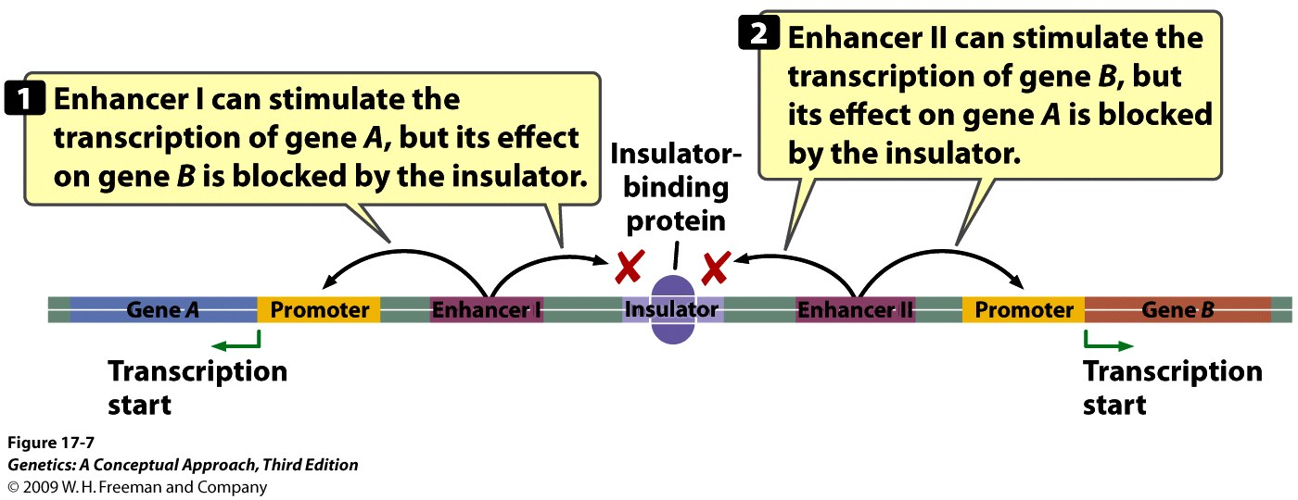
Repressors: Bind to sequences in the regulatory promoter or to the distant sequence called silencers
Insulator: DNA sequence that blocks or insulates the effect of enhancers in aposition dependent manner via specific proteins bind to them

Slide 24
Coordinated gene regulation
  Eukaryotic genes may be activated by the same stimulus – For example many cells respond to extreme heat by producing Heat-shock proteins
  Response elements (contain short consensus sequences): common regulatory elements upstream of the start sites of a collective group of genes in response to a common environmental stimulus

Slide 25
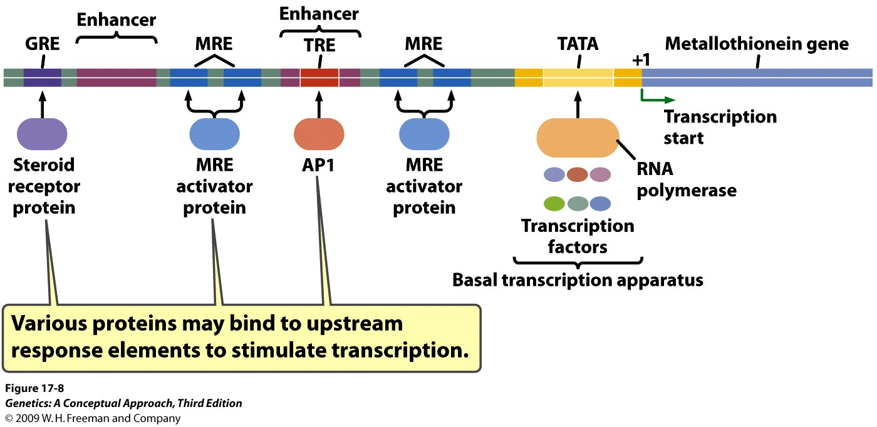
  A single eukaryotic genes can be regulated by several different response elements found in both, promoter and enhancer
Metallothionein gene - protects cells from the toxicity of heavy metals – multiple response elements (MRE)
Notes:
Figure 17.8 Multiple response elements (MREs) are found in the upstream region of the metallothionein gene. The basal transcription apparatus binds near the TATA box. In response to heavy metals, activator proteins bind to several MREs and stimulate transcription. The TRE response element is the binding site for transcription factor AP1, which is stimulated by phorbol esters. In response to glucocorticoid hormones, steroid-receptor proteins bind to the GRE response element located approximately 250 nucleotides upstream of the metallothionein gene and stimulate transcription.

Slide 26
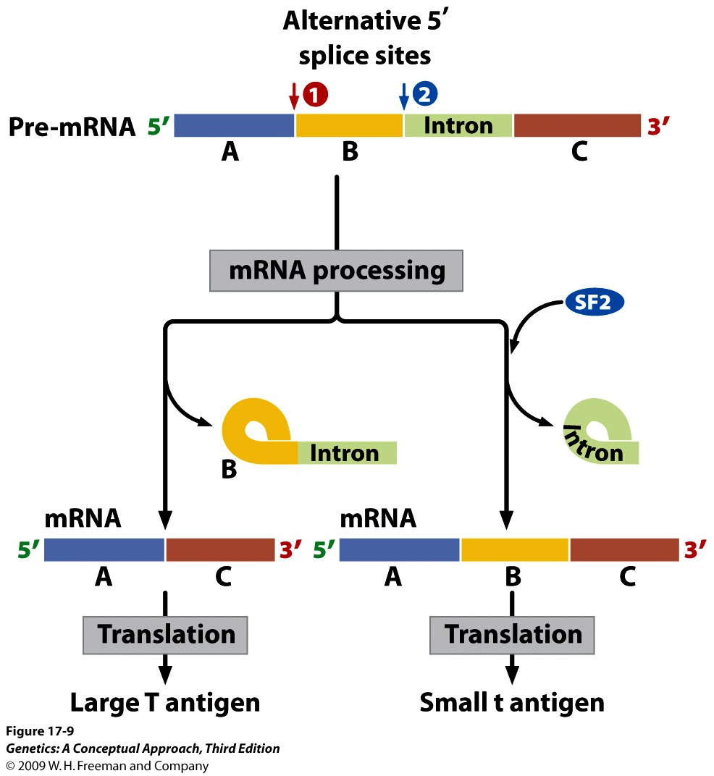
Gene regulation through RNA splicing
Alternative splicing leads to the production of the small t and large T antigen in the mammalian virus SV40 (Simian vacuolating virus 40)

Slide 27
Some Genes Are Regulated by RNA Processing and Degradation
The degradation of RNA – eukaryotic RNA is degraded by ribonucleases in several pathways:
  5′-cap removal followed by removal of nucleotides
  Shortening of the poly(A) tail
  Degradation of 5′ UTR, coding sequence, and 3′ UTR – contains AU-rich sequence - miRNA

Slide 28
RNA Interference Is an Important Mechanism of Gene Regulation
Mechanisms of Gene regulation by RNA interference:
  RNA cleavage: RISC (RNA-induced silencing complex) containing an siRNA, pair with mRNA molecules and cleavage to the mRNA
  Inhibition of translation
  Transcriptional silencing: altering chromatin structure

Slide 29
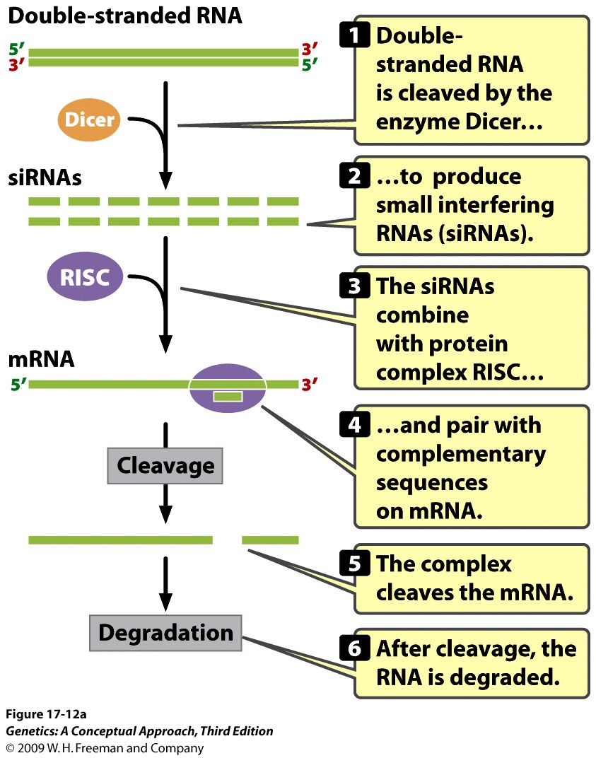
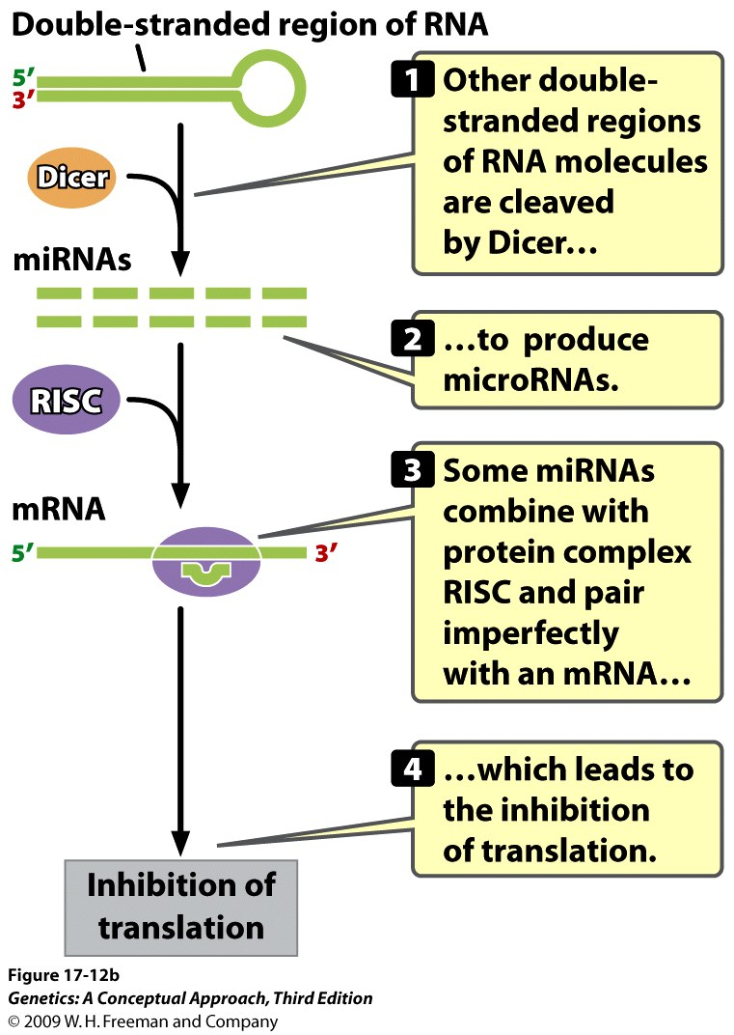
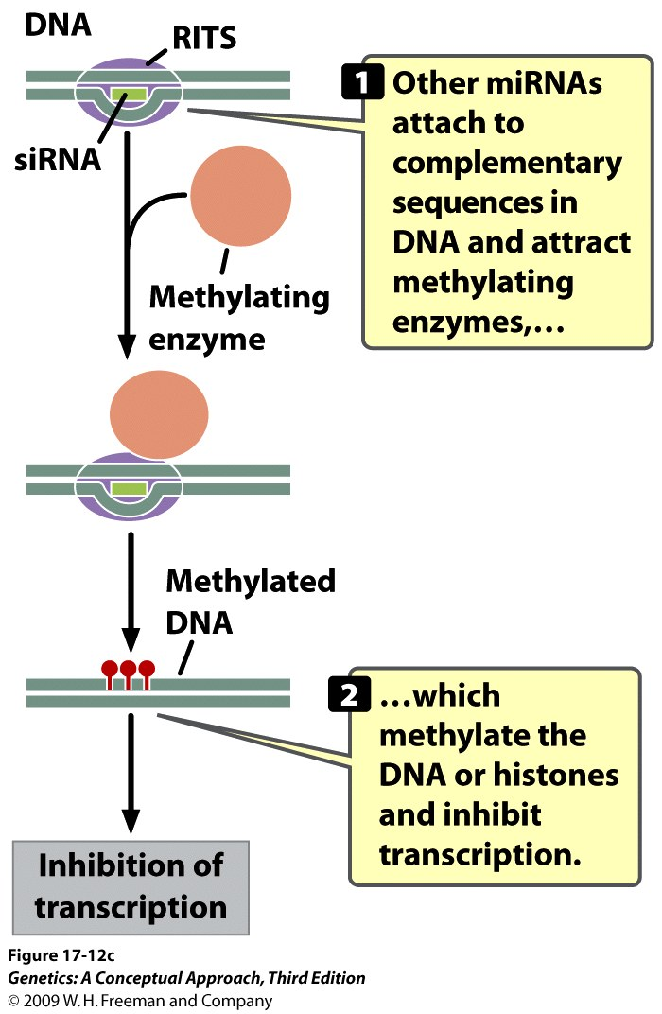
Inhibition of Translation:
Transcriptional Silencing :
RNA cleavage:
Notes:
Figure 17.12a RNA silencing leads to the degradation of mRNA, or the inhibition of translation or transcription. Small interfering RNAs (siRNAs) degrade mRNA by cleavage.

Slide 30
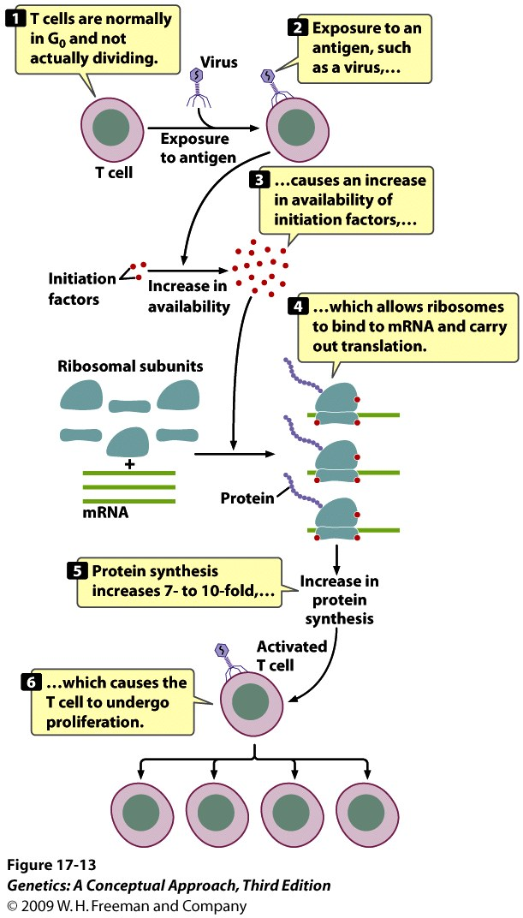
Some Genes Are Regulated by Processes That Affect Translation or by Modification of Proteins
Exposure to an antigen stimulates an increased availability of initiation factors and subsequent increase in protein synthesis leading to T cell proliferation

Slide 31
Levels of Gene Regulation
1.
2.
3.
4.
5.
6.

Slide 32
Concept Check 1
How do amino acids in DNA-binding proteins interact with DNA?
  By forming covalent bonds with DNA base
  By forming hydrogen bonds with DNA base
  By forming covalent bonds with sugars
Notes:
H bonds

Slide 33
Concept Check 1
How do amino acids in DNA-binding proteins interact with DNA?
  By forming covalent bonds with DNA base
  By forming hydrogen bonds with DNA base
  By forming covalent bonds with sugars

Slide 34
Concept Check 2
What is the difference between a structural gene and a regulator gene?
  Structural genes are transcribed into mRNA, but regulator genes are not.
  Structural genes have complex structures; regulator genes have simple structure.
  Structural genes encode proteins that function in the structure of the cell; regulator genes carry out metabolic reactions.
  Structural genes encode proteins; regulator genes control the transcription of structural genes.

Slide 35
Concept Check 2
What is the difference between a structural gene and a regulator gene?
  Structural genes are transcribed into mRNA, but regulator genes are not.
  Structural genes have complex structures; regulator genes have simple structure.
  Structural genes encode proteins that function in the structure of the cell; regulator genes carry out metabolic reactions.
  Structural genes encode proteins; regulator genes control the transcription of structural genes.

Slide 36
Concept Check 3
In a negative repressible operon, the regulator protein is synthesized as .
  an active activator
  an inactive activator
  an active repressor
  an inactive repressor

Slide 37
Concept Check 3
In a negative repressible operon, the regulator protein is synthesized as .
  an active activator
  an inactive activator
  an active repressor
  an inactive repressor

Slide 38
Concept Check 4
In the presence of allolactose, the lac repressor .
  binds to the operator
  binds to the promoter
  cannot bind to the operator
  binds to the regulator gene

Slide 39
Concept Check 4
In the presence of allolactose, the lac repressor .
  binds to the operator
  binds to the promoter
  cannot bind to the operator
  binds to the regulator gene

Slide 40
Concept Check 5
Most transcriptional activator proteins affect transcription by interacting with .
  introns
  the basal transcription apparatus
  DNA polymerase
  nucleosomes

Slide 41
Concept Check 5
Most transcriptional activator proteins affect transcription by interacting with .
  introns
  the basal transcription apparatus
  DNA polymerase
  nucleosomes

